Slide 1
ChessSimulator
A chess simulation engine in R
R6 OOP · Rcpp / C++ · Shiny · R package
Ondřej Marvan · 477001 · Advanced Programming in R · WNE UW

Slide 2
The problem
Not a dataset analysis — a reusable simulation engine.
How do you compare decision-making strategies when the outcome depends on an opponent?
Chess as a testbed
Fully observable, deterministic rules, unambiguous outcome. A strategy either wins or it does not.
Strategies are pluggable
Any object implementing choose_move() can enter. Adding a new AI needs no change to the game loop.
Measurable
Round-robin tournaments turn 'is this strategy better?' into a leaderboard.

Slide 3
Architecture
Each class owns one thing. That separation is what makes the AI pluggable.
Square
Piece
Board
Game
Tournament
file + rank
validation
1-64 index
type, colour
position
engine code
32 pieces
move generation
attack detection
make / unmake
turn order
end conditions
move log
round robin
leaderboard
Player (abstract)
defines one method — choose_move(board, legal_moves)
RandomPlayer
GreedyPlayer
MinimaxPlayer
random legal move
1 ply, pure R
alpha-beta, C++
Game never asks which kind of player it has.

Slide 4
R6: inheritance and polymorphism
One method name, three strategies. Adding a fourth changes nothing else.
# Base class — the interface, deliberately unimplemented
Player <- R6Class("Player", public = list(
choose_move = function(board, moves) stop("Abstract")
))
# Child 1 — random baseline
RandomPlayer <- R6Class("RandomPlayer", inherit = Player,
public = list(choose_move = function(board, moves)
moves[[ sample.int(length(moves), 1L) ]]))
# Child 2 — delegates the hard part to C++
MinimaxPlayer <- R6Class("MinimaxPlayer", inherit = Player,
public = list(choose_move = function(board, moves)
chess_minimax(board$encode_for_engine(), +1L, self$depth)))

Slide 5
Why R6: mutability earns its place
Legal-move filtering plays and retracts thousands of moves. Copying the board would be wasteful.
legal_moves = function(colour) {
legal <- list()
for (mv in self$pseudo_moves(colour)) {
rec <- self$apply_move(mv$from, mv$to, log = FALSE) # play it
ok <- !self$is_in_check(colour) # look
self$undo_move(rec) # retract
if (ok) legal <- c(legal, list(mv))
}
legal
}
The undo record stores the captured piece, the pre-promotion type and the has-moved flag, so the position is restored exactly. With S3 or S4 every trial move would mean a new object.

Slide 6
Rcpp: the search, in C++
Depth 3 evaluates tens of thousands of positions per move. This is the hot loop.
int search(int b[64], int depth, int alpha, int beta,
bool white_to_move, int ply) {
std::vector<Move> moves;
gen_legal(b, white_to_move, moves);
if (moves.empty()) { // game ends here
if (in_check(b, white_to_move)) // mate: prefer it sooner
return white_to_move ? -(MATE_SCORE - ply)
: (MATE_SCORE - ply);
return 0; // stalemate = draw
}
if (depth <= 0) return evaluate(b);
order_moves(b, moves); // MVV-LVA first
// ... alpha-beta loop: if (beta <= alpha) break;
}

Slide 7
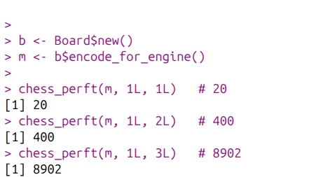
Proving the move generator is correct
perft counts leaf nodes in the game tree. The values are published and unforgiving.
depth
nodes
expected
Why this matters
1
20
20
=
One illegal move generated, or one legal move missed, and these counts break immediately.
It is the difference between an engine that looks like it works and one that is demonstrably right.
The same check runs from R as chess_perft() and inside the test suite.
2
400
400
=
3
8,902
8,902
=
4
197,281
197,281
=

Slide 8
What went wrong first
The first working version played legal-looking moves and still lost to random. Three real bugs.
Knight and bishop shared one code
Both encoded as 3, so the generator emitted knight jumps and bishop slides for either piece.
→ Unique code per type: P 1, N 2, B 3, R 4, Q 5, K 6
No check filtering
Only pseudo-legal moves. Kings were left under attack, captured, and games ended as "stalemate".
→ Legal moves = play, test the king, retract
No move ordering or mate score
Alpha-beta pruned almost nothing and the search had no notion of winning.
→ MVV-LVA ordering + mate scores that prefer faster mates
perft was the tool that found the first two — the counts were wrong before anything else looked wrong.

Slide 9
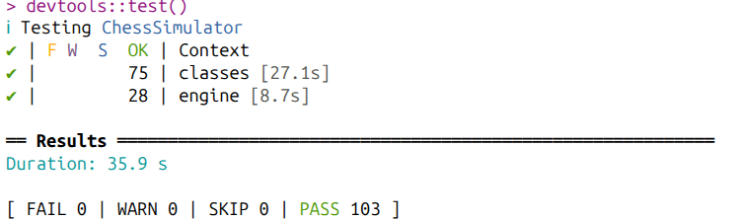
Testing strategy
103 tests. Two of them found bugs I had not noticed.
perft
move generator against published counts
Two bugs the suite caught
to_matrix() wrote rank-1 pieces into the row labelled 8 — the board displayed vertically mirrored, in the console and in Shiny.
is_light_square() was inverted, so a1 rendered light when it should be dark.
Both were invisible while only reading the code.
R vs C++
two independent generators must return the identical move set at every position
make / unmake
board must be byte-identical after retracting a move
Fool's mate
known 4-ply mate must be detected as mate
strength
minimax must actually beat random

Slide 10
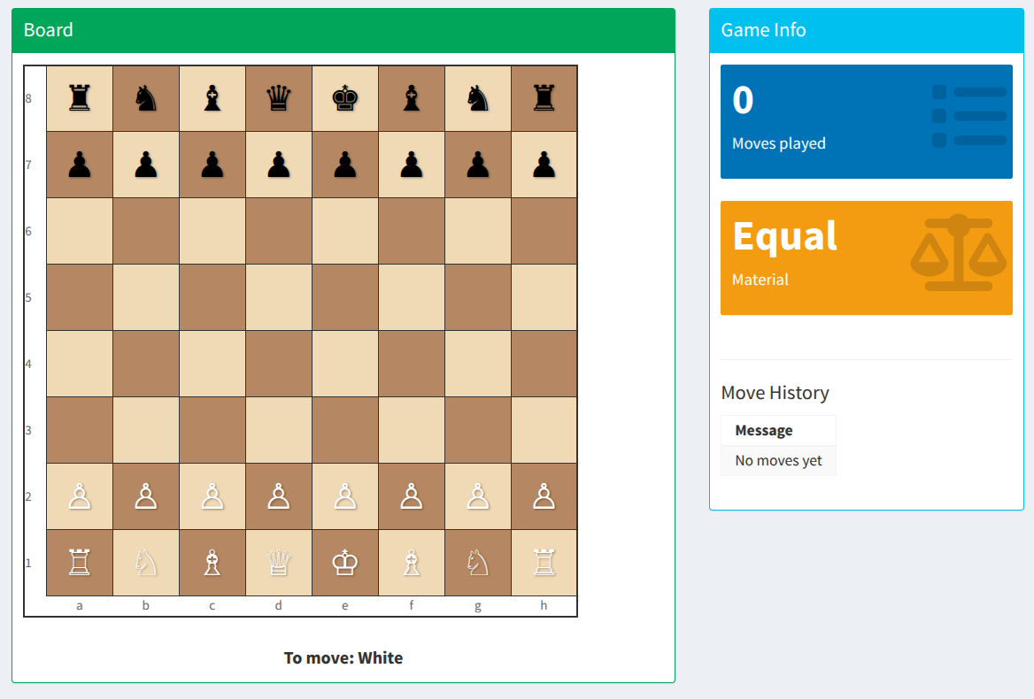
Shiny dashboard
R6 mutability and Shiny reactivity meet in three lines.
observeEvent(input$btn_next_move, {
game <- game_rv()
game$play_one_turn() # R6 mutates in place
game_rv(game) # write back -> redraw
})
The game object is mutated, not replaced. Shiny tracks assignment into the reactiveVal, not the internal state of an object — so the write-back is what redraws the board.
Also used: reactiveTimer for auto-play, isolate to read inputs without subscribing, withProgress for tournaments.

Slide 11
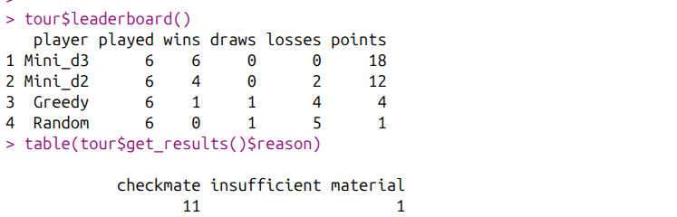
Does the search actually help?
Round robin, every pairing both colours. 11 of 12 games ended in checkmate.
player
W
D
L
pts
Reading the ladder
Mini_d3
6
0
0
18
Random loses to everything.
Greedy takes material one ply ahead and beats Random, but never asks what the reply will be.
Depth 2 beats Greedy. Depth 3 beats depth 2 head to head and finishes undefeated.
Deeper search wins — which is the claim the whole engine exists to support.
Mini_d2
4
0
2
12
Greedy
1
1
4
4
Random
0
1
5
1

Slide 12
Packaging
Installable, documented, tested.
ChessSimulator/
Why split the C++ in two
├── DESCRIPTION LinkingTo: Rcpp
chess_core.h contains no Rcpp at all, so the chess logic compiles and runs under a plain g++ — the perft check does not need R.
chess_engine.cpp only converts an 8x8 matrix to a flat array and back.
Logic that can be tested without the binding layer is logic you can trust.
├── NAMESPACE useDynLib + importFrom(Rcpp, evalCpp)
├── R/
│ ├── chess_R6_classes.R
│ ├── chess_game.R
│ └── wrappers.R make_player, play_game, ...
├── src/
│ ├── chess_core.h pure C++, no Rcpp
│ └── chess_engine.cpp thin Rcpp bindings
A packaging note
├── inst/shiny/app.R
The test suite passed while the dashboard crashed: package code resolves names through its own namespace, script code does not. An argument for packaging.
└── tests/testthat/

Slide 13
Limitations and what comes next
What the engine does not do, stated plainly.
Not implemented
Castling, en passant, under-promotion. Pawns always promote to a queen. Threefold repetition is not detected; the fifty-move rule and insufficient material are.
Search depth
Fixed depth with no quiescence search, so the engine can misjudge a position in the middle of a capture sequence.
Next steps
Quiescence search, a transposition table, and iterative deepening — each one is a measurable improvement the leaderboard could verify.
None of these change the architecture: a stronger search is still just another choose_move().

Slide 14
Thank you
exact
103 pass
undefeated at depth 3
perft 1-4
tests
engine
Questions
Ondřej Marvan · 477001

